Slide 1
How to use this Guide
As Canada’s population continues to age, herpes zoster (commonly known as shingles) represents a growing public health issue for older adults. The risk of shingles increases with age, with the highest burden among those aged 50 years and over. Infection can result in serious health outcomes, including bacterial skin infections, postherpetic neuralgia, and, in some cases, hearing and vision complications.
To strengthen public understanding of the risks and complications associated with shingles, as well as preventive actions such as vaccination, the International Federation on Ageing (IFA) is actively engaging in a targeted campaign for Shingles Awareness Week (SAW) 2026, held from 23 February to 1 March.
SAW is an opportunity to raise awareness of shingles as a vaccine preventable disease and foster increased knowledge and action. The purpose of this guide is to provide an accessible and adaptable resource that will allow your organization to tailor content to ensure it is relevant to the community you represent. Feel welcome to brand the resource with your organization’s logo, with space being created on the top portion of each page to promote your organization.
Steps to make this guide your own:
Remove page 1 of the document
Upload your logo to the banner of the remaining pages
Review content to see if additional information or context is needed for the population you represent
Share the resource during Shingles Awareness Week from 23 February to 1 March, using the hashtag #ShinglesAwarenessWeek, #SAW26, and #ShinglesActionWeek

Slide 2

( YOUR ORGANIZATION’S LOGO HERE )
Shingles
Awareness Week 2026
23 February – 1 March 2026

Slide 3

Background
Shingles Awareness Week
Shingles Awareness Week (SAW) 2026 builds on previous awareness and advocacy efforts to strengthen understanding of shingles and its complications, while promoting tangible actions to improve access, uptake, and equity in shingles vaccination across Canada.
For more additional resources visit: www.vaccines4life.com/engage/saw2026
What is Shingles?
Shingles is a painful viral infection caused by the same virus as chickenpox, which may reactivate years later to cause a blistering rash and intense pain, typically affecting one side of the torso.
Certain groups are more vulnerable to shingles, including those who are:
Older adults (especially those 50+)
People with chronic conditions (like diabetes or respiratory illnesses)
Immunocompromised (e.g., people undergoing chemotherapy, organ transplant recipients, or those living with HIV)
These individuals are also at higher risk of complications and other long-term health impacts.

Slide 4
Sample Social Media Posts
Social media post #1
Are you aged
50 years or older?
You may be eligible for the
shingles vaccine, available at pharmacies, doctor’s offices, and public health clinics across Canada. However, access can vary depending on your location and healthcare coverage.
This Shingles Awareness Week, [insert organization] is calling for stronger policies to support equitable access to shingles vaccination.
Social media post #2
Did you know…
i
Did you know that 1 in 3 Canadians will experience shingles in their lifetime? Most cases occur in adults aged 50 years and over.
Equitable access to vaccination is essential to help protect older adults from shingles.

Slide 5

Sample Social Media Posts
Social media post #3
Shingles is a painful condition that can affect anyone who has had chickenpox or received the chickenpox vaccine. The risk increases with age, particularly for adults aged 50 years and over.
This Shingles Awareness Week, [organization] is helping raise awareness of shingles, its potential complications, and the importance of prevention as we age.
Social media post #4
Shingles remains an important but often overlooked health issue for older adults.
This Shingles Awareness Week, [organization] is raising awareness of shingles and the importance of prevention for older adults.

Slide 6

Social Media Hashtags #
Hashtags to use for Shingles Awareness Week 2026
#ShinglesAwarenessWeek
#SAW26
#ShinglesActionWeek
#PreventShingles
#GetVaccinated

Slide 7
Adaptable Press Release Template
[Organization] Recognizes Shingles Awareness Week and Emphasizes the Importance of Vaccination for Older Adults
As part of Shingles Awareness Week, [Organization] is raising awareness of shingles and its impact on older adults, while reinforcing the importance of equitable access to prevention across Canada.
Shingles is a viral infection caused by the same virus as chickenpox. Following initial infection, the virus can remain dormant in the body and reactivate later in life, leading to a painful rash and, in some cases, long-term complications such as postherpetic neuralgia, a persistent nerve pain that can significantly affect daily functioning and quality of life.
Approximately one in three people will develop shingles during their lifetime. The risk increases with underlying chronic conditions and age, with the highest burden observed among adults aged 50 years and over. Older adults are also more likely to experience complications, prolonged pain, and increased use of health-care services.
Vaccination is an important preventive measure that can help reduce the risk and severity of shingles and its complications. However, access to shingles vaccination varies across Canada depending on jurisdiction, coverage, and availability.
During Shingles Awareness Week, [Organization] is calling for strengthened public awareness efforts and improved access to shingles prevention for populations at highest risk, including older adults and individuals who are immunocompromised.
Supporting equitable access to prevention is a key step toward reducing avoidable illness, easing pressure on health systems, and advancing healthy ageing for all Canadians.

Slide 8
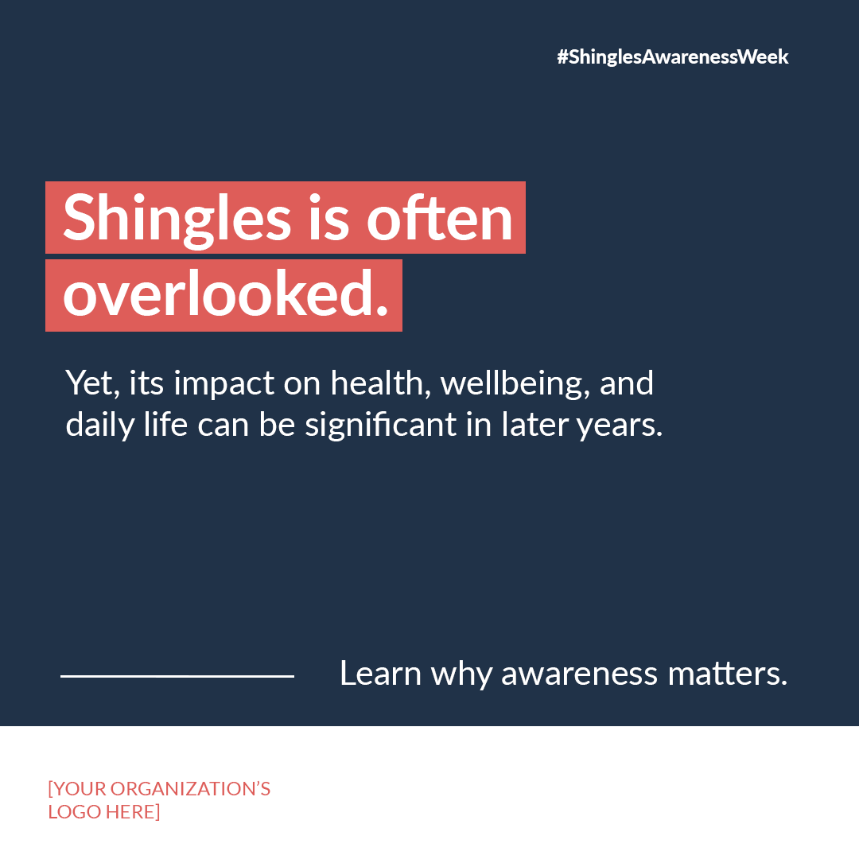
Adaptable SAW Tile
Adaptable Tile Sample #1
This image is for reference only. To customize, please use the Adaptable Tiles file included in the toolkit

Slide 9
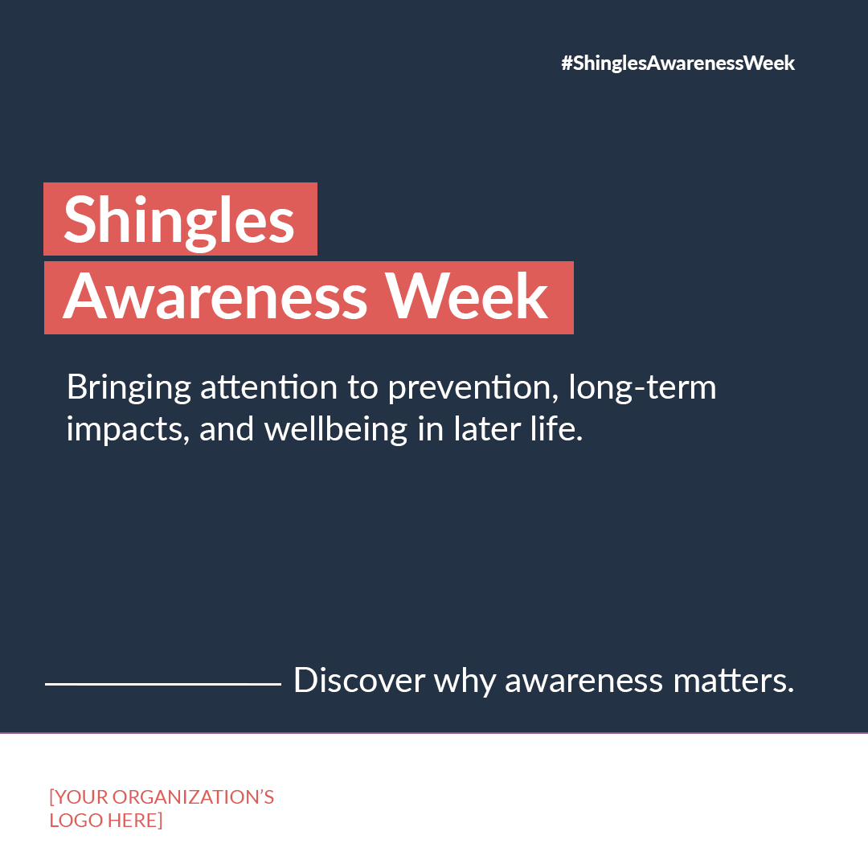
Adaptable SAW Tile
Adaptable Tile Sample #2
This image is for reference only. To customize, please use the Adaptable Tiles file included in the toolkit

Slide 10
How do I Promote Awareness?
Vaccination is a safe and easy way to protect yourself from the potentially lifelong impacts of shingles. The IFA has created a bank of resources in advance of Shingles Awareness Week and encourages you to use these resources to spread knowledge and promote action in response to shingles.
This initiative has been supported by an unrestricted educational grant from GSK

Slide 11
References
Prevention C for DC and. Cause and Transmission | CDC [Internet]. 2023 [cited 2026 Jan 29]. Available from: https://www.cdc.gov/shingles/about/transmission.html
Government of Canada. Herpes zoster (shingles) vaccine: Canadian Immunization Guide [Internet]. 2023 [cited 2026 Jan 29]. Available from: https://www.canada.ca/en/public-health/services/publications/healthy-living/canadian-immunization-guide-part-4-active-vaccines/page-8-herpes-zoster-(shingles)-vaccine.html#a2
Shingles | Johns Hopkins Medicine [Internet]. [cited 2026 Jan 29]. Available from: https://www.hopkinsmedicine.org/health/conditions-and-diseases/shingles
Dooling K, Anderson T. Centers for Disease Control and Prevention. 2023 [cited 2026 Jan 29]. Five Things You Should Know About Shingles. Available from: https://www.cdc.gov/shingles/5-things-you-should-know.html
Lang PO, Govind S, Michel JP, Aspinall R, Mitchell WA. Immunosenescence: Implications for vaccination programmes in adults. Maturitas. 2011 Apr 1;68(4):322–30.
Allen JC, Toapanta FR, Chen W, Tennant SM. Understanding immunosenescence and its impact on vaccination of older adults. Vaccine [Internet]. 2020 Dec;38(52):8264–72. Available from: https://linkinghub.elsevier.com/retrieve/pii/S0264410X20314262
Bhavsar A, Lonnet G, Wang C, Chatzikonstantinidou K, Parikh R, Brabant Y, et al. Increased Risk of Herpes Zoster in Adults ≥50 Years Old Diagnosed With COVID-19 in the United States. Open Forum Infect Dis [Internet]. 2022 May 1;9(5). Available from: https://academic.oup.com/ofid/article/doi/10.1093/ofid/ofac118/6545460

